Slide 1
Myntra Data Set Analysis
Yamunesh Patadia 92200584028
Sahil Sheikh 92200584037

Slide 2
Introduction
Objective of the New System
Automate data analysis and visualization for Myntra sales data to improve efficiency and insight generation.
Problem Definition
Manual, time-consuming data analysis process, resulting in errors and inconsistent results.
Core Components
Data Extraction
Data Transformation
Data Cleaning
Data Analysis
Data Visualization

Slide 3
Introduction
Project Profile
Phase 1: Requirements Gathering
Phase 2: System Design & Development
Phase 3: System Testing & Deployment
Assumptions and Constraints
Accessible Myntra sales database
Required resources available
Skilled project team
Sufficient budget

Slide 4
Introduction
Advantages and Limitations of the Proposed System
Advantages:
Increased efficiency
Reduced errors
Improved insights
Enhanced accessibility
Limitations:
Dataset accuracy dependence
User's basic knowledge required
Limited scope for some data requests

Slide 5
2. Requirement Determination & Analysis
Requirement Determination
Utilized user interviews, surveys, and focus groups to gather key requirements.
Targeted Users
Data analysts and business users at Myntra.
Data analysts use the system for data analysis.
Business users make informed decisions based on insights.
Tool details
Python selected as the development language.
Python's suitability for data analysis and visualization.
Overview of key Python libraries to be used.

Slide 6
2. Requirement Determination & Analysis
Library description
Pandas: Data manipulation and analysis.
NumPy: Array operations and mathematical functions.
Matplotlib: Visualization with various charts and graphs.
Seaborn: Higher-level interface for statistical graphics.

Slide 7
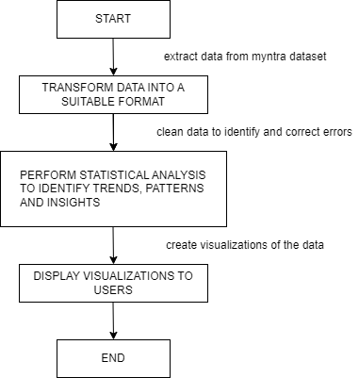
3. System Design
Flowchart:

Slide 8
3. System Design
Dataset design
Relational database structure.
Tables: Products, Sales, Customers.
Foreign key relationships between tables for data integrity.
Details on preprocessing steps applied
Data cleaning: Removing errors, duplicates, and missing values.
Data transformation: Converting data into suitable formats.
Feature engineering: Creating new features from existing data.
UI design
Web-based application.
User-friendly and accessible.
Main components: Data selection, Analysis options, Visualization options, Visualization display.
Export options for visualizations.

Slide 9
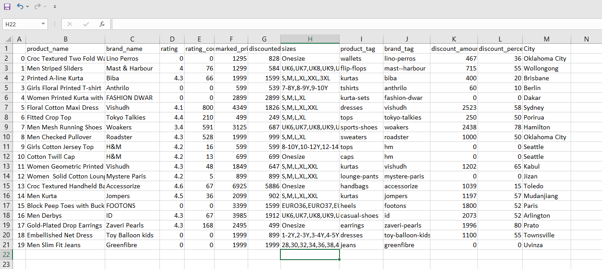
4. Development
Code:
Myntra Sales Dataset:

Slide 10
4. Development
# Import necessary libraries
import pandas as pd
# Load the dataset
data = pd.read_csv('MyntraDataSet.csv')
# Display the first five rows of the dataset
print(data.head())
product_name brand_name rating rating_count \
0 Croc Textured Two Fold Wallet Lino Perros 0.0 0
1 Men Striped Sliders Mast & Harbour 4.0 76
2 Printed A-line Kurta Biba 4.3 66
3 Girls Floral Printed T-shirt Anthrilo 0.0 0
4 Women Printed Kurta with Skirt FASHION DWAR 0.0 0

Slide 11
4. Development
marked_price discounted_price sizes \
0 1295 828 Onesize
1 1299 584 UK6,UK7,UK8,UK9,UK10,UK11
2 1999 1599 S,M,L,XL,XXL,3XL
3 599 539 7-8Y,8-9Y,9-10Y
4 2899 2899 S,M,L,XL
product_link \
0 wallets/lino-perros/lino-perros-women-peach-co...
1 flip-flops/mast--harbour/mast--harbour-men-nav...
2 kurtas/biba/biba-women-off-white--black-printe...
3 tshirts/anthrilo/anthrilo-girls-white-floral-p...
4 kurta-sets/fashion-dwar/fashion-dwar-women-mul...

Slide 12
4. Development
img_link product_tag \
0 https://assets.myntassets.com/dpr_2,q_60,w_210... wallets
1 https://assets.myntassets.com/dpr_2,q_60,w_210... flip-flops
2 https://assets.myntassets.com/dpr_2,q_60,w_210... kurtas
3 https://assets.myntassets.com/dpr_2,q_60,w_210... tshirts
4 https://assets.myntassets.com/dpr_2,q_60,w_210... kurta-sets
brand_tag discount_amount discount_percent Unnamed: 13 Order Date \
0 lino-perros 467 36 NaN 11-11-2021
1 mast--harbour 715 55 NaN 05-02-2021
2 biba 400 20 NaN 17-10-2021
3 anthrilo 60 10 NaN 28-01-2021
4 fashion-dwar 0 0 NaN 05-11-2021

Slide 13
4. Development
Ship Date City
0 13-11-2021 Oklahoma City
1 07-02-2021 Wollongong
2 18-10-2021 Brisbane
3 30-01-2021 Berlin
4 06-11-2021 Dakar

Slide 14
4. Development
# Summary statistics
summary = data.describe()
summary
Rating rating_count marked_price discounted_price discount_amount \
count 52038.00 52038.000 52038.000000 52038.000000 52038.000000
mean 2.066327 60.506514 2472.660248 1481.337696 991.322553
std 2.103646 585.330688 2318.276451 1689.222533 1266.709366
min 0.000000 0.000000 55.000000 49.000000 0.000000
25% 0.000000 0.000000 1248.000000 664.000000 188.000000
50% 0.000000 0.000000 1990.000000 999.000000 700.000000
75% 4.200000 20.000000 2995.000000 1708.750000 1320.000000
max 5.000000 55900.0000 113999.0000 45900.000000 68400.000000

Slide 15
4. Development
discount_percent Unnamed: 13
52038.000000 0.0
37.148757 NaN
24.889723 NaN
0.000000 NaN
15.000000 NaN
40.000000 NaN
60.000000 NaN
90.000000 NaN
# Data types and missing values
info = data.info()
info

Slide 16
4. Development
RangeIndex: 52038 entries, 0 to 52037
Data columns (total 17 columns):
# Column Non-Null Count Dtype
0 product_name 52038 non-null object
1 brand_name 52038 non-null object
2 rating 52038 non-null float64
3 rating_count 52038 non-null int64
4 marked_price 52038 non-null int64
5 discounted_price 52038 non-null int64
6 sizes 52038 non-null object
7 product_link 52038 non-null object
8 img_link 52038 non-null object
9 product_tag 52038 non-null object
10 brand_tag 52038 non-null object
11 discount_amount 52038 non-null int64
12 discount_percent 52038 non-null int64
13 Unnamed: 13 0 non-null float64
14 Order Date 51290 non-null object
15 Ship Date 51290 non-null object
16 City 51290 non-null object
dtypes: float64(2), int64(5), object(10)
memory usage: 6.7+ MB

Slide 17
4. Development
# Unique values in categorical columns
unique_values = data.nunique()
unique_values
product_name 18710
brand_name 2658
rating 40
rating_count 870
marked_price 2020
discounted_price 3169
sizes 1694
product_link 43646
img_link 43645
product_tag 315
brand_tag 2658
discount_amount 3075
discount_percent 91
Unnamed: 13 0
Order Date 366
Ship Date 373
City 3650
dtype: int64

Slide 18
4. Development
# Get the data types of each column in the 'data' DataFrame
data_types = data.dtypes
data_types
product_name object
brand_name object
rating float64
rating_count int64
marked_price int64
discounted_price int64
sizes object
product_link object
img_link object
product_tag object
brand_tag object
discount_amount int64
discount_percent int64
Unnamed: 13 float64
Order Date object
Ship Date object
City object
dtype: object

Slide 19
4. Development
# Check for missing values
missing_values = data.isnull().sum()
missing_values
brand_name 0
rating 0
rating_count 0
marked_price 0
discounted_price 0
sizes 0
product_link 0
img_link 0
product_tag 0
brand_tag 0
discount_amount 0
discount_percent 0
Unnamed: 13 52038
Order Date 748
Ship Date 748
City 748
dtype: int64

Slide 20
4. Development
# Removing unwanted columns from the dataset.
data.drop(['product_link', 'img_link','Unnamed: 13'], axis=1, inplace=True)
# filling missing of Order Date column in dataset
mode_of_order_date=data['Order Date'].mode()[0]
data['Order Date'].fillna(value=mode_of_order_date,inplace=True)
# filling missing of Ship Date column in dataset
mode_of_ship_date=data['Ship Date'].mode()[0]
data['Ship Date'].fillna(value=mode_of_ship_date,inplace=True)
# filling missing of City column in dataset
mode_of_city=data['City'].mode()[0]
data['City'].fillna(value=mode_of_city,inplace=True)

Slide 21
4. Development
# obtain the shape of a DataFrame
data.shape
Output :
(52038, 14)
# Calculate the average rating and total rating count from the 'data' dataset.
avg_rating = data['rating'].mean() # Calculate the mean of the 'rating' column.
total_rating_count = data['rating_count'].sum() # Calculate the sum of 'rating_count' column.
# Display the results.
print("Average Rating:", avg_rating)
print("Total Rating Count:", total_rating_count)
Output :
Average Rating: 2.066326530612245
Total Rating Count: 3148638

Slide 22
4. Development
# Calculate the average discount percentage by brand and display the top 10 results.
# Group the data by 'brand_name' and calculate the mean of 'discount_percent' within each group.
avg_discount= data.groupby('brand_name')['discount_percent'].mean().head(10)
# Print the calculated average discounts for the top 10 brands.
print("Average Discount by Brand:")
print(avg_discount)
Output :
Average Discount by Brand:
brand_name
1 Stop Fashion 75.000000
20Dresses 27.041885
39 THREADS 40.000000
3PIN 43.000000
4711 27.500000
513 40.000000
7Threads 70.454545
883 Police 33.600000
98 Degree North 63.090909
999Store 64.941176
Name: discount_percent, dtype: float64

Slide 23
4. Development
# Sort the 'data' DataFrame by 'discounted_price' in descending order
# to show the highest discounted prices first, and display the top rows.
sorted_df = data.sort_values(by='discounted_price', ascending=False)
sorted_df.head()
Output :
product_name brand_name rating rating_count marked_price \
29599 Men Automatic Motion Watch D1 Milano 0.0 0 51000
27039 Lord Krishna Showpiece eCraftIndia 0.0 0 113999
13309 Women Square Sunglasses Tom Ford 0.0 0 41900
20538 Women Aviator Sunglasses Tom Ford 0.0 0 40900
8809 Casual Shirt Polo Ralph Lauren 0.0 0 39000

Slide 24
4. Development
discounted_price sizes product_tag brand_tag discount_amount \
45900 Onesize watches d1-milano 5100
45599 Onesize showpieces ecraftindia 68400
41900 M sunglasses tom-ford 0
40900 L sunglasses tom-ford 0
39000 38,42.5,44 shirts polo-ralph-lauren 0
discount_percent Order Date Ship Date City
10 01-11-2021 05-11-2021 Los Angeles
60 20-08-2021 24-08-2021 Lawrence
0 08-07-2021 14-07-2021 Sincan
0 03-08-2021 08-08-2021 Riyadh
0 17-06-2021 17-06-2021 Carrefour

Slide 25
4. Development
# Find the index of the brand and product with the highest total sales.
sales_by_brand_tag = data.groupby(['brand_tag', 'product_tag'])['discounted_price'].sum()
sales_by_brand_tag
max_sales_index = sales_by_brand_tag.idxmax()
print("Brand and Product with Highest Total Sales:")
max_sales_index
Output :
Brand and Product with Highest Total Sales:
('jc-collection', 'dresses')
# Calculate and retrieve the top 15 cities with the highest average discount amounts
avg_discount_by_city= data.sort_values(by='discount_amount', ascending=False).head(15)
# Display the resulting DataFrame containing the cities and their average discounts
avg_discount_by_city.head()

Slide 26
4. Development
Output :
product_name brand_name rating \
27039 Lord Krishna Showpiece eCraftIndia 0.0
18316 Textured 360-Degree Rotation Hard-Sided… Safari 0.0
25265 Gold-Plated Stone-Studded Jewellery Set Silvermerc Designs 0.0
24736 Gold Plated Jewellery Set Silvermerc Designs 0.0
15422 Gold Plated Jewellery Set Silvermerc Designs 0.0
rating_count marked_price discounted_price sizes product_tag brand_tag \
0 113999 45599 Onesize showpieces ecraftindia
0 32997 9239 Pack trolley-bag safari
0 29500 5900 Onesize jewellery-set silvermerc-designs
0 29000 5800 Onesize jewellery-set silvermerc-designs
0 29000 5800 Onesize jewellery-set silvermerc-designs

Slide 27
4. Development
discount_amount discount_percent Order Date Ship Date City
68400 60 20-08-2021 24-08-2021 Lawrence
23758 72 01-06-2021 06-06-2021 Zanjan
23600 80 06-10-2021 10-10-2021 Rugby
23200 80 27-09-2021 30-09-2021 Detroit
23200 80 08-08-2021 14-08-2021 Harrow
# Analyzing Discounts by Brand and City
# Grouping the data by 'brand_name' and calculating the average discount percentage for each brand.
avg_discount_by_brand = data.groupby('brand_name')['discount_percent'].mean()
# Grouping the data by 'City' and finding the maximum discount percentage offered in each city.
max_discount_by_city = data.groupby('City')['discount_percent'].max()
# The 'avg_discount_by_brand' Series now contains the average discount percentage for each brand,
# which provides insights into how brands are pricing their products.
avg_discount_by_brand

Slide 28
4. Development
Output :
brand_name
1 Stop Fashion 75.000000
20Dresses 27.041885
39 THREADS 40.000000
3PIN 43.000000
4711 27.500000
…..
x2o 74.000000
yelloe 51.666667
yoho 29.000000
zebu 57.400000
zink Z 10.000000
Name: discount_percent, Length: 2658, dtype: float64

Slide 29
4. Development
# The 'max_discount_by_city' Series displays the maximum discount percentage available in each city
max_discount_by_city
Output :
City
Aachen 83
Aalen 0
Aalst 60
Aba 86
Abadan 60
...
Zwedru 53
Zwickau 30
Zwolle 50
eMbalenhle 25
Águas Lindas de Goiás 65
Name: discount_percent, Length: 3650, dtype: int64

Slide 30
4. Development
# Calculate the discounted percentage for each item in the dataset.
# The discounted percentage is obtained by dividing the discount amount
# by the marked price and then multiplying by 100 to express it as a percentage.
data['discounted_percent'] = (data['discount_amount'] / data['marked_price']) * 100
data.head()
Output :
product_name brand_name rating rating_count marked_price \
0 Croc Textured Two Fold Wallet Lino Perros 0.0 0 1295
1 Men Striped Sliders Mast & Harbour 4.0 76 1299
2 Printed A-line Kurta Biba 4.3 66 1999
3 Girls Floral Printed T-shirt Anthrilo 0.0 0 599
4 Women Printed Kurta with Skirt FASHION DWAR 0.0 0 2899

Slide 31
4. Development
discounted_price sizes product_tag brand_tag discount_amount \
828 Onesize wallets lino-perros 467
584 UK6,UK7,UK8,UK9,UK10,UK11 flip-flops mast—harbour 715
1599 S,M,L,XL,XXL,3XL kurtas biba 400
539 7-8Y,8-9Y,9-10Y tshirts anthrilo 60
2899 S,M,L,XL kurta-sets fashion-dwar 0
discount_percent Order Date Ship Date City discounted_percent
36 11-11-2021 13-11-2021 Oklahoma City 36.061776
55 05-02-2021 07-02-2021 Wollongong 55.042340
20 17-10-2021 18-10-2021 Brisbane 20.010005
10 28-01-2021 30-01-2021 Berlin 10.016694
0 5-11-2021 06-11-2021 Dakar 0.000000

Slide 32
4. Development
# This allows us to explore the dataset with the most positively rated items at the top.
sorted_by_rating = data.sort_values(by='rating', ascending=False)
sorted_by_rating.head()
product_name brand_name rating rating_count \
32472 Opaque Casual Shirt URBANIC 5.0 5
49615 Checked Pinafore Dress Nauti Nati 5.0 4
6509 Printed Elevated Bottom Jumpsuit Juniper 5.0 5
45510 Pack of 4 Patterned Socks Bonjour 5.0 5
5130 EDGE T-shirts HRX by Hrithik Roshan 5.0 6
marked_price discounted_price sizes product_tag brand_tag \
1490 745 M,L,XL shirts urbanic
1799 719 4Y,5Y,6Y,7Y,8Y dresses nauti-nati
2799 951 S,M,L,XL,XXL jumpsuit juniper
396 396 6-8Y socks bonjour
2199 1209 XS,S,M,L,XL tshirts hrx-by-hrithik-roshan

Slide 33
4. Development
discount_amount discount_percent Order Date Ship Date City discounted_percent
745 50 23-09-2021 29-09-2021 Goiânia 50.000000
1080 60 18-11-2021 23-11-2021 Brumado 60.033352
1848 66 26-06-2021 28-06-2021 Pingnan 66.023580
0 0 25-11-2021 30-11-2021 Buenos Aires 0.000000
990 45 16-07-2021 20-07-2021 Genk 45.020464

Slide 34
4. Development
# Data Visualization
import matplotlib.pyplot as plt
import seaborn as sns
# Create a histogram of ratings
# This code generates a histogram to visualize the distribution of ratings in the 'data' dataset.
# - The 'plt.hist' function is used to create the histogram.
# - We specify 'data['rating']' as the data source, 'bins=10' for 10 equally spaced bins,
# 'color='skyblue'' to set the histogram bars' color, and 'edgecolor='black'' to define the edge color.
# - 'plt.xlabel' and 'plt.ylabel' set labels for the x and y axes, respectively.
# - 'plt.title' assigns a title to the histogram.
# - Finally, 'plt.show()' displays the histogram.
plt.hist(data['rating'], bins=10, color='skyblue', edgecolor='black')
plt.xlabel('Rating')
plt.ylabel('Frequency')
plt.title('Distribution of Ratings')
plt.show()

Slide 35
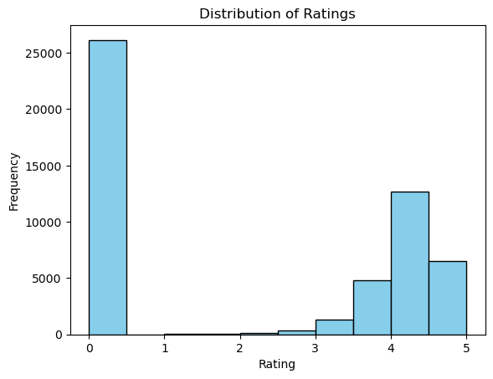
4. Development

Slide 36
4. Development
# Bar Chart of Brands
import seaborn as sns
# Create a bar chart of the top 10 brands from the 'data' dataset using Seaborn.
# Extract the counts of each brand and select the top 10 most frequent ones.
top_brands = data['brand_name'].value_counts().head(10)
# Set the figure size for the bar chart.
plt.figure(figsize=(10, 6))
# Generate a bar plot using Seaborn, with brand counts on the x-axis and brand names on the y-axis.
# The 'viridis' palette is used for coloring the bars.
sns.barplot(x=top_brands.values, y=top_brands.index, palette='viridis')
plt.xlabel('Count')
plt.ylabel('Brand Name')
# Set the title for the chart.
plt.title('Top 10 Brands’)
plt.show()

Slide 37
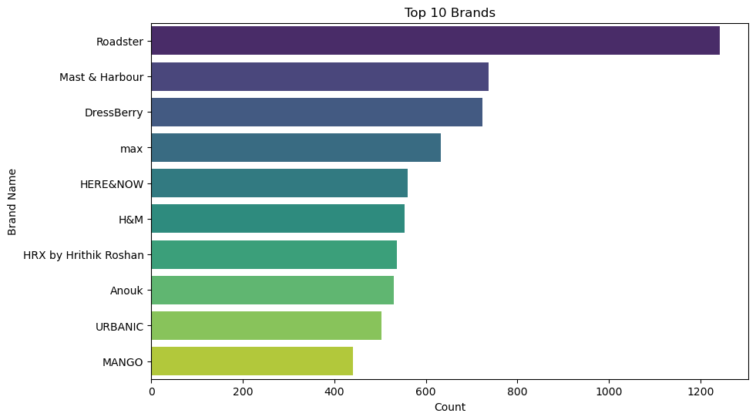
4. Development

Slide 38
4. Development
# A correlation matrix provides insights into the relationships between numerical variables in the dataset.
# First, calculate the correlation matrix for the dataset 'data'.
correlation_matrix = data.corr(numeric_only=True)
# Next, create a plot for the correlation matrix using Seaborn and Matplotlib.
# Set the figure size to 10x8 inches.
plt.figure(figsize=(10, 8))
# Create a heatmap of the correlation matrix with annotations.
# Use the 'coolwarm' color map to represent correlations, format values with two decimal places, and add small gaps between cells.
sns.heatmap(correlation_matrix, annot=True, cmap='coolwarm', fmt='.2f', linewidths=0.5)
# Set the title for the plot.
plt.title('Correlation Matrix')
plt.show()

Slide 39
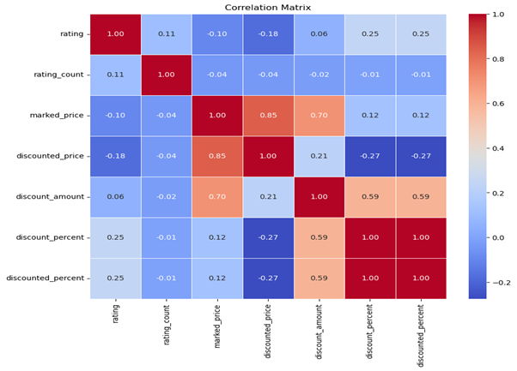
4. Development

Slide 40
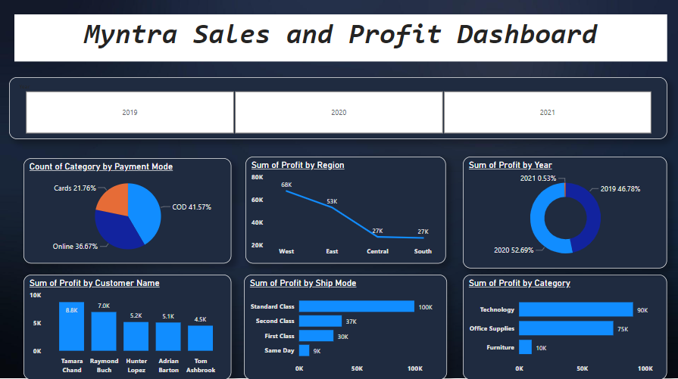
4. Development

Slide 41
5. Proposed Enhancements
Real-Time Data Analysis and Visualization
Provide real-time insights to users for up-to-the-minute trends and patterns.
Implement streaming data processing and real-time visualization libraries.
Predictive Analytics
Empower users to predict future trends and patterns.
Incorporate machine learning libraries for predictive modeling
Implementation Examples:
Real-Time Data Analysis: Streaming data processing and real-time visualization libraries.
Predictive Analytics: Machine learning libraries for predictive modeling.

Slide 42
6. Conclusion
The proposed system is the answer to the challenges of manual and time-consuming data analysis.
It promises enhanced efficiency, effectiveness, and deeper insights into Myntra sales data.

Slide 43
7. Bibliography
Kaggle: Data science and machine learning resources.
https://www.kaggle.com
OpenAI Chat: AI and natural language processing.
https://chat.openai.com
Google BARD: Data visualization tools and resources.
https://bard.google.com
Pandas: Data manipulation and analysis library.
https://pandas.pydata.org
Matplotlib: Data visualization library.
https://matplotlib.org

